Slide 1




Server for uploading Deep Learning Model
+
MongoDB
Server for File Upload
IoT Server Platform

Slide 2
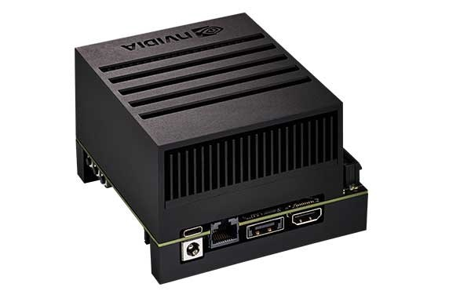

Server for uploading Deep Learning Model
Send Create CIN (Content Instance) Request including Download URL
+
MongoDB
Server for File Upload
IoT Server Platform
Upload Trained Model File
(TRT converted file, edgeTPU compiled file)
Local Computing System

Slide 3
Server for uploading Deep Learning Model
Send Create CIN (Content Instance) Request including Download URL
+
MongoDB
Server for File Upload
IoT Server Platform
{
"m2m:cin": {
...
"con": {
"id": "618b41b083466e82c5e0072e",
"filename": "frozen_graph.pb",
"url": "http://localhost:3000/models/download
?cnt=model
&id=618b41b083466e82c5e0072e
&filename=frozen_graph.pb"
}
}
}
Upload Trained Model File
(TRT converted file, edgeTPU compiled file)
Local Computing System

Slide 4
Server for uploading Deep Learning Model
File Download
Send File Download Request
+
MongoDB
Server for File Upload
IoT Server Platform
Send GET CIN (Content Instance) Request
Local Computing System
Parsing File Download URL from CIN

